Slide 1
All Average NBA Team
By: David Roycroft and Billy Fryer

Slide 2
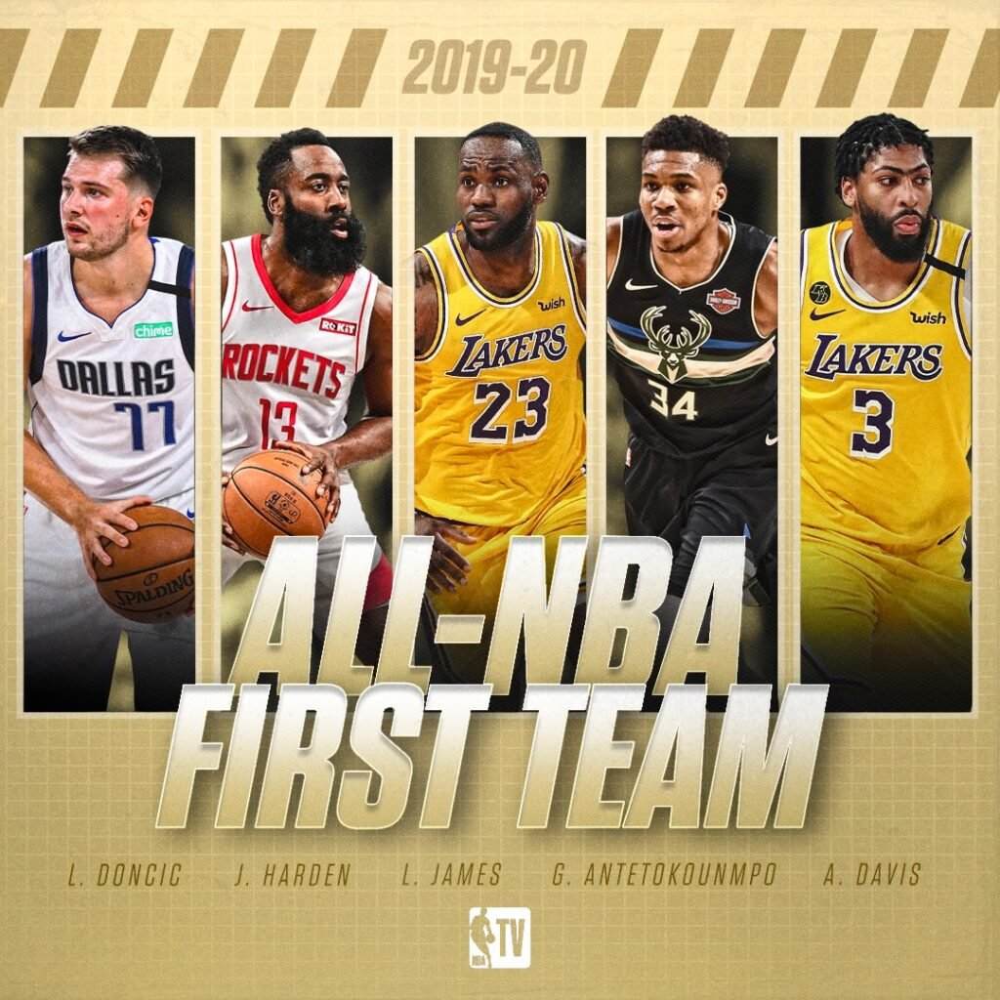
Notes:
Billy

Slide 3
What if instead we made a team of the most statistically average players in the league?
Notes:
Billy

Slide 4
Eligible Players
We had to make a games and minutes played restriction
More than 19 Games Played (~25% of NBA Games in a Normal Year)
More than 240 Minutes Played (1 Quarter Played Per Game)
Notes:
David

Slide 5
SScD: Sum of Scaled Differences
“Differences”
Took each player’s per game stats – median of all players
Took the Absolute Value to get how far from ”Average” they are
This is because we wanted the closest player to average, regardless of whether the player was above or below the real average
“Scaled”
Difference – min / range
We did this for every player and every statistic in the data set
This makes all statistics weigh of equal importance
The sum of these is each player’s SScD
Notes:
Billy

Slide 6
SScD: Sum of Scaled Differences Part 2
Then we broke players up by position
Ranked players from “Most Average” to “Least Average” by position
Notes:
Billy

Slide 7
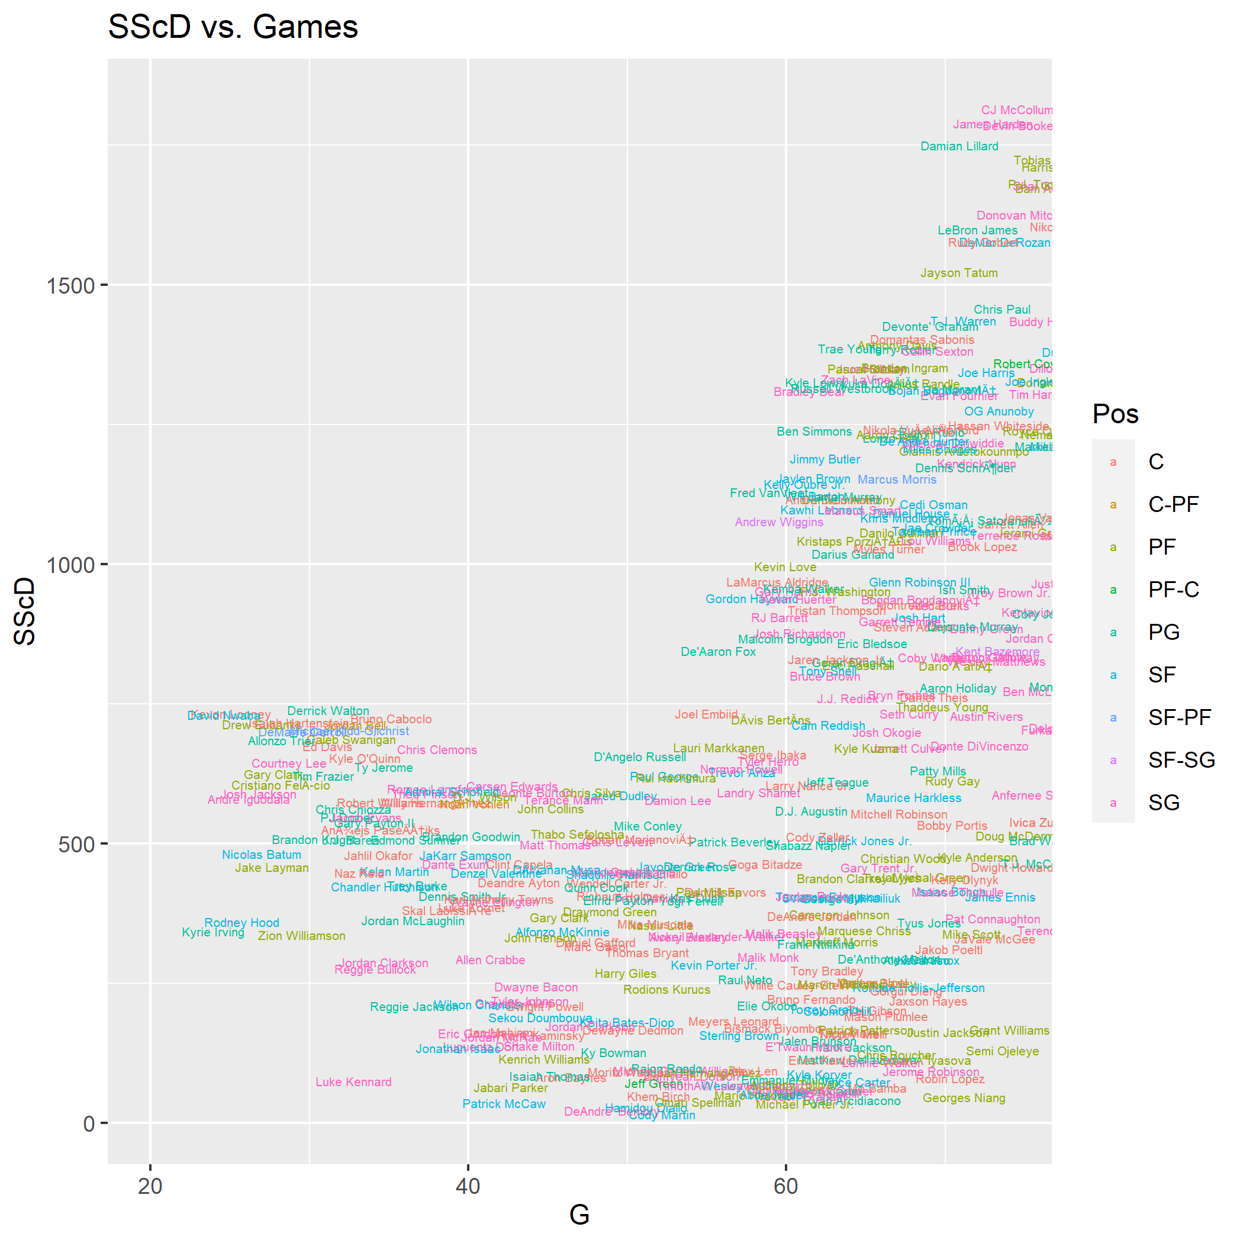
Notes:
David

Slide 8
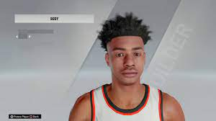
The “Average” Player
PPG: 8.94
RPG: 3.75
APG: 1.65
SScD: 0
Notes:
David

Slide 9
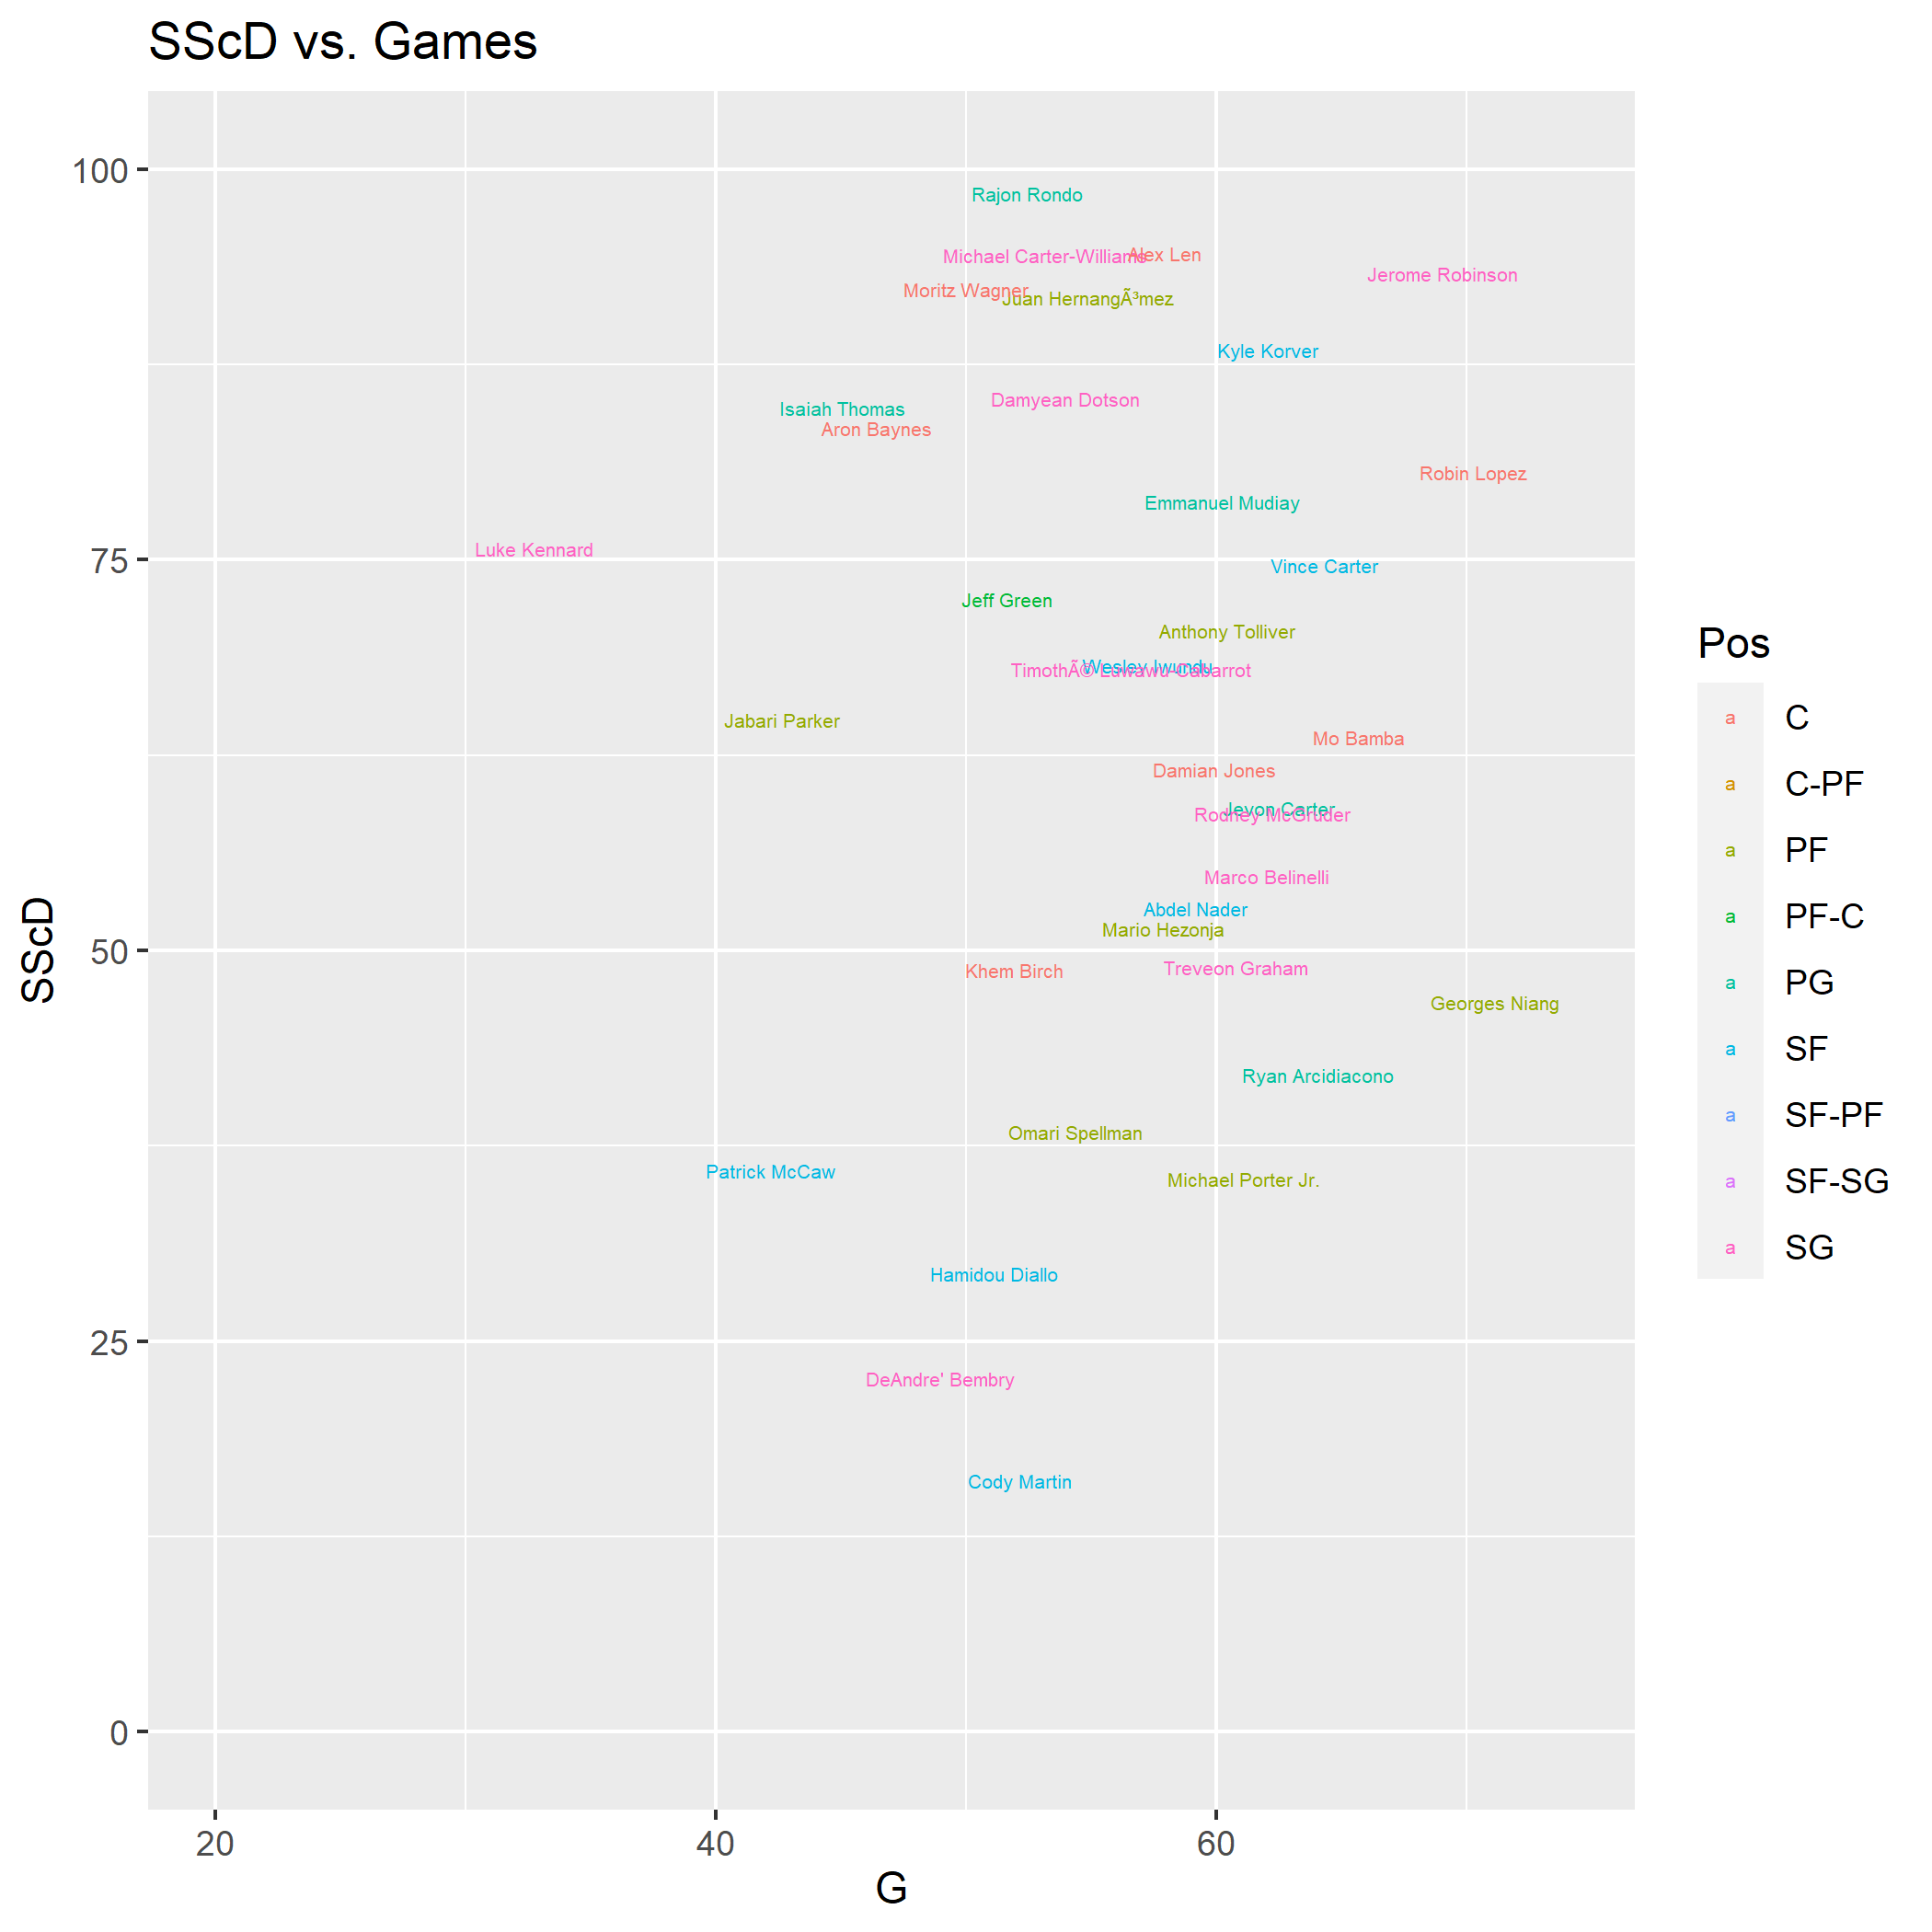
Notes:
David

Slide 10
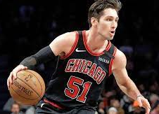
Point Guard: Ryan Arcidiacono
PPG: 4.50
RPG: 1.90
APG: 1.66
SScD: 42.03829
Notes:
David

Slide 11
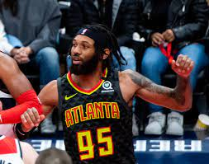
Shooting Guard: De'Andre Bembry
PPG: 5.79
RPG: 3.53
APG: 1.88
SScD: 22.59081
Notes:
David

Slide 12
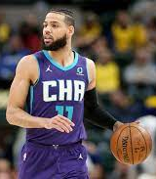
Small Forward: Cody Martin
PPG: 4.96
RPG: 3.29
APG: 1.98
SScD: 16.11058
Notes:
David

Slide 13
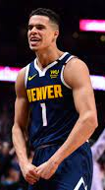
Power Forward: Michael Porter Jr
PPG: 9.31
RPG: 4.71
APG: 0.84
SScD: 35.38824
Notes:
David

Slide 14
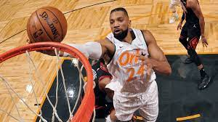
Center: Khem Birch
PPG: 4.42
RPG: 4.58
APG: 1.04
SScD: 48.78179
Notes:
David

Slide 15
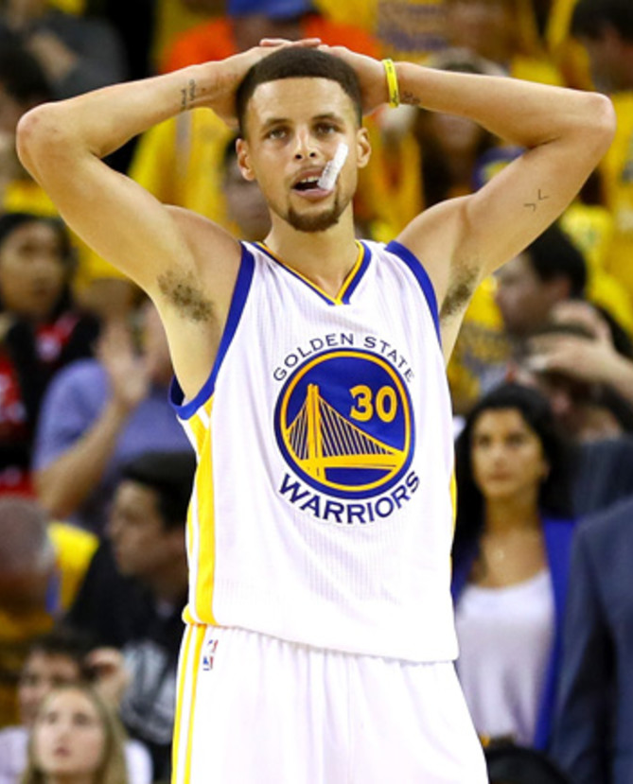
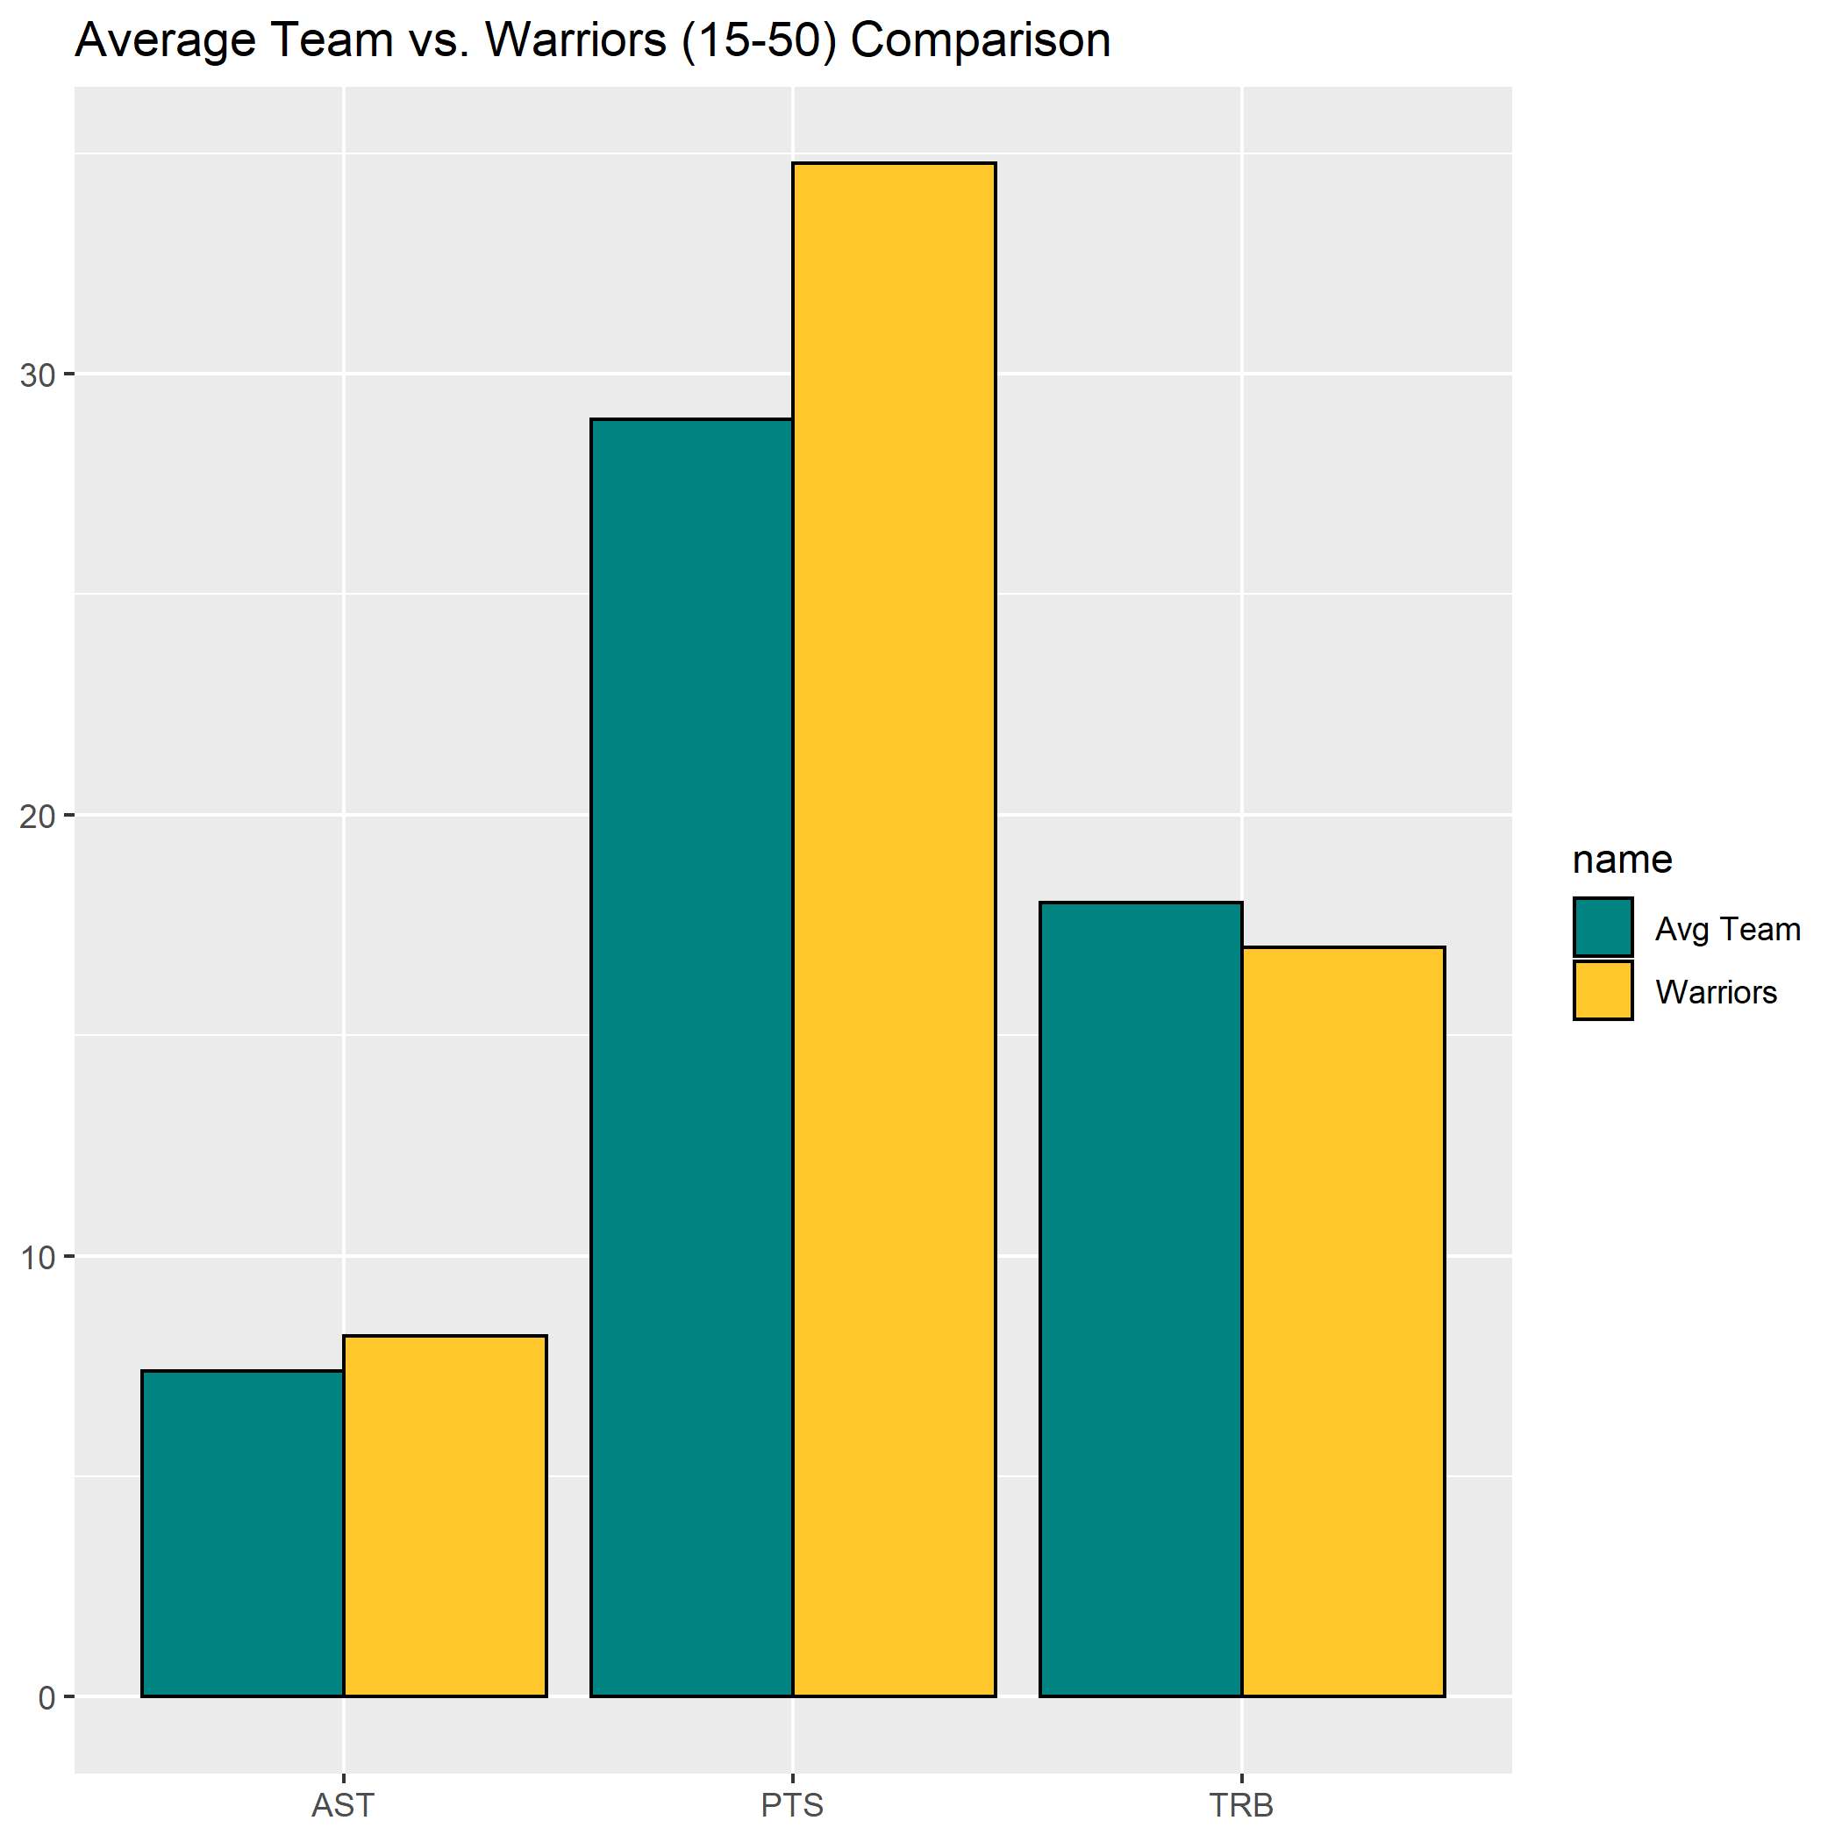

Slide 16
What if we did the opposite, the “Least Average” Team?
Notes:
Billy

Slide 17
Notes:
David

Slide 18
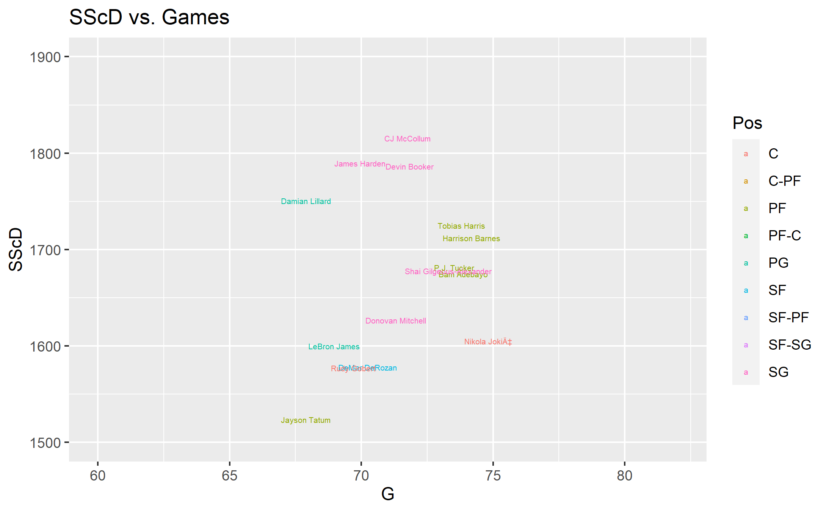

Slide 19
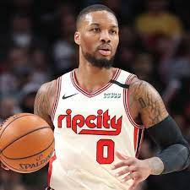
Point Guard: Damian Lillard
PPG: 29.97
RPG: 4.30
APG: 8.03
SScD: 1750.534

Slide 20
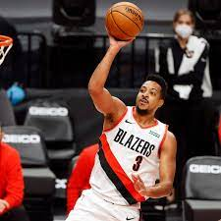
Shooting Guard: CJ McCollum
PPG: 22.23
RPG: 4.24
APG: 4.43
SScD: 1815.458

Slide 21
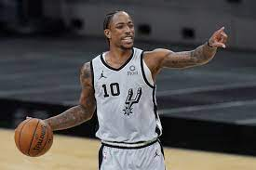
Small Forward: Demar DeRozan
PPG: 22.12
RPG: 5.51
APG: 5.59
SScD: 1577.813

Slide 22
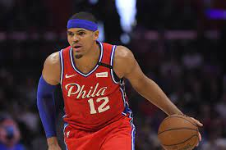
Power Forward: Tobias Harris
PPG: 19.60
RPG: 6.88
APG: 3.15
SScD: 1725.210

Slide 23
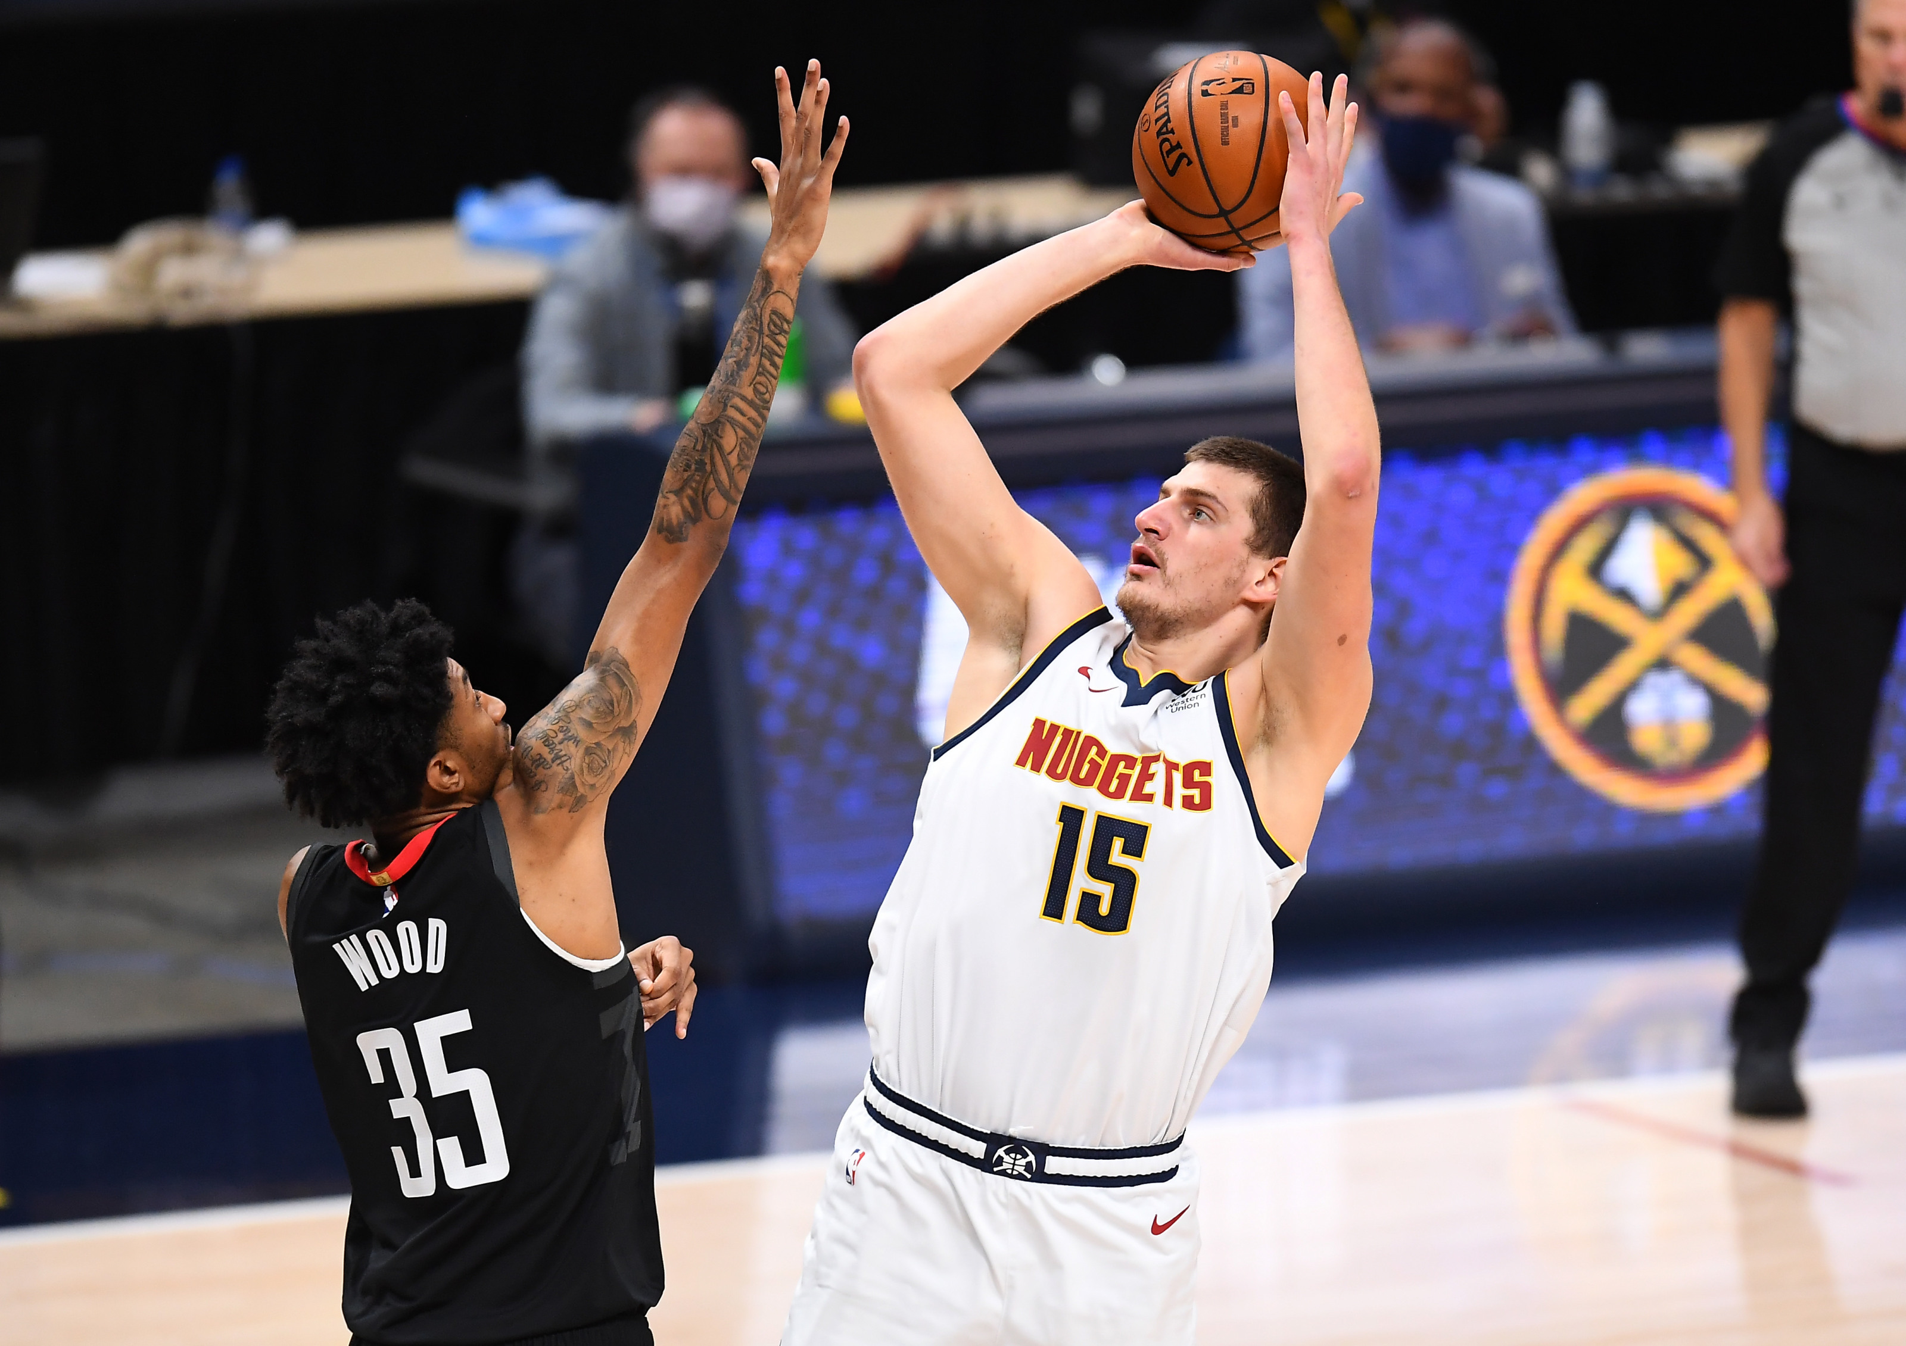
Center: Nikola Jokic
PPG: 19.95
RPG: 9.74
APG: 7.01
SScD: 1605.292

Slide 24
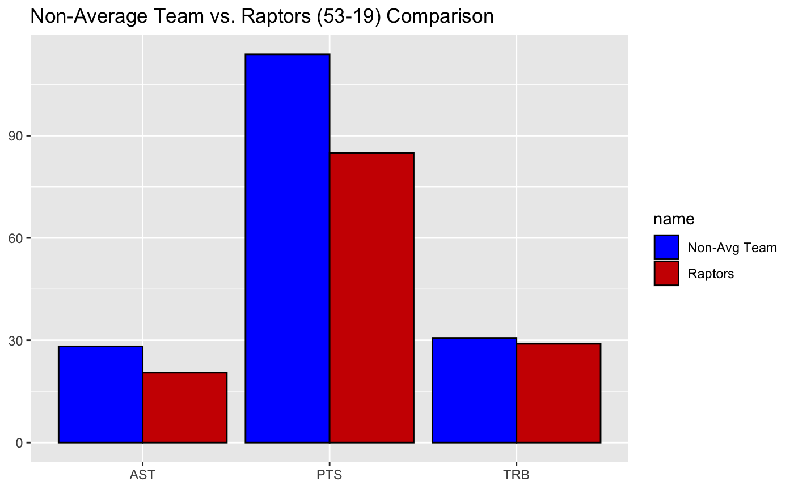
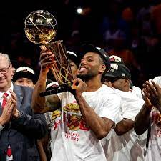
Notes:
Billy

Slide 25
Conclusion
Although the 2019-20 season did not include some star players such as Stephen Curry and Kevin Durant, the Non-Average team was comprised of “less” famous players who play in smaller markets, thereby giving credence to the idea that there is still some balance across teams in the NBA.
Notes:
Billy Introduce, David pitch in as he sees fit

